Slide 1
FINAL PROJECT · VIBE CODING CEDIA 2026
VibeAutomateResearchTool
Traceable evidence assistant with human approval
Patricio Simbaña Escobar · Universidad UTE · School of Architecture and Urbanism
Miguel Ángel Botto Tobar · University of Guayaquil · School of Mathematical and Physical Sciences
Project guide 08 · AI-native research
Narration generated with an AI voice (ElevenLabs) and reviewed by the authors.
Vibe Coding CEDIA 2026 · Universidad UTE · UTPL
1 / 10
Notes:
COVER
NARRATION · ≈15 s · 30–40 words in English
We present Vibe Automate Research Tool. It is an assistant that shows where every claim comes from. We are Patricio Simbaña from U T E and Miguel Ángel Botto Tobar from the University of Guayaquil.

Slide 2
FINAL PROJECT · VIBE CODING CEDIA 2026
The problem
Separate windows: the trail of every figure is lost.
A CONCRETE EXAMPLE
Scopus AI: 18 to 85 % savings. Operating data: 7 % (campus) and ≈ 20 % (building).
Vibe Coding CEDIA 2026 · Universidad UTE · UTPL
2 / 10
Notes:
PART A · PRESENTATION (3 min in total)
THE PROBLEM · NARRATION · ≈35 s · 80–90 words
Teachers and researchers search, extract and summarize in separate windows. In the end they cannot tell where each figure came from. This affects anyone who writes a literature review or a project proposal. Here is an example with rainwater harvesting at universities. Scopus A I answered that savings range from eighteen to eighty-five percent. In the sources with operating data the picture is different. Rain covered seven percent of the demand of one campus. In one building it covered about twenty percent.

Slide 3
FINAL PROJECT · VIBE CODING CEDIA 2026
The tool
WHO USES IT
WHAT GOES IN
WHAT COMES OUT
Instructors and researchers
Question, criteria and 5 abstracts with DOI
Signed evidence table and synthesis
Vibe Coding CEDIA 2026 · Universidad UTE · UTPL
3 / 10
Notes:
THE TOOL · NARRATION · ≈30 s · 70–80 words
The tool is for teachers and researchers who prepare a literature review. It takes a research question, three criteria and five abstracts with their D O I. It returns an evidence table and a short synthesis. Every claim carries the exact passage and the signature of the person who approved it. We built it following guide eight of the Vibe Coding course. It runs in a Claude Project and a spreadsheet.

Slide 4
FINAL PROJECT · VIBE CODING CEDIA 2026
How it works
1 · INPUT
2 · AI
3 · REVIEW
4 · RESULT
Question, criteria, sources
Follows written rules
Approves, corrects or rejects; signs
Signed rows only
No signature, no decision.
Vibe Coding CEDIA 2026 · Universidad UTE · UTPL
4 / 10
Notes:
HOW IT WORKS · NARRATION · ≈40 s · 95–105 words
It works in four steps. In the input step the person sets the question, the criteria and the sources. Then the A I follows written instructions. It proposes to include or exclude each source. It extracts fields with their exact passage and drafts the synthesis. Next comes the review. The person approves, corrects or rejects each proposal and signs with a name and a date. A decision without a signature does not count. Finally the spreadsheet checks with formulas that every passage is literal. The synthesis uses only signed rows. Nothing is sent and no external system is changed.

Slide 5
FINAL PROJECT · VIBE CODING CEDIA 2026
Evidence that it works
5/11
13/13
2/7
AI errors caught
literal passages, checked by formula
Scopus AI claims confirmed
Five public abstracts · 19 of 19 decisions signed.
Vibe Coding CEDIA 2026 · Universidad UTE · UTPL
5 / 10
Notes:
EVIDENCE · NARRATION · ≈35 s · 80–90 words
We tested the tool with five abstracts on rainwater harvesting. The A I made eleven extraction proposals and five of them were wrong. The human review corrected four and rejected one. Thirteen of thirteen passages appear word for word in the publisher's abstract. All five claims in the synthesis trace back to signed rows. Only two of seven claims from Scopus A I matched the abstracts. The tool also passed tests with an instruction hidden inside an abstract and with a broken identifier.

Slide 6
FINAL PROJECT · VIBE CODING CEDIA 2026
Limits and responsible use
WHAT IT DOES NOT DO
DATA AND PRIVACY
NEXT STEP
Abstracts only; 5 of 39 records
Sends and changes nothing
Moodle seminar
Vibe Coding CEDIA 2026 · Universidad UTE · UTPL
6 / 10
Notes:
LIMITS AND RESPONSIBLE USE · NARRATION · ≈25 s · 55–65 words
The tool has clear limits. It works only with abstracts and three rows need the full text. We evaluated five of thirty-nine records. That is not enough to generalize a savings range. It does not send messages or change external systems. Our next step is a seminar in Moodle and a program that stops the flow until approval.

Slide 7
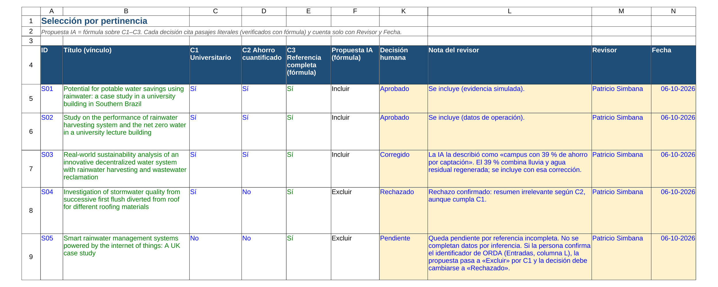
FINAL PROJECT · VIBE CODING CEDIA 2026
Demo · Input
Selection: the AI proposes, the person decides and signs
Vibe Coding CEDIA 2026 · Universidad UTE · UTPL
7 / 10
Notes:
PART B · DEMO (2 min in total)
NARRATION · ≈30 s · 70–80 words in English
Let us look at the tool. The sheets are in Spanish. This is the selection sheet. Each source keeps its identifier in every stage. The A I proposes to include or exclude it using three written criteria. On the right is the human decision with reviewer and date. The abstract on roof water quality was rejected because it reports no savings. The incomplete reference stayed pending and no data was invented.

Slide 8
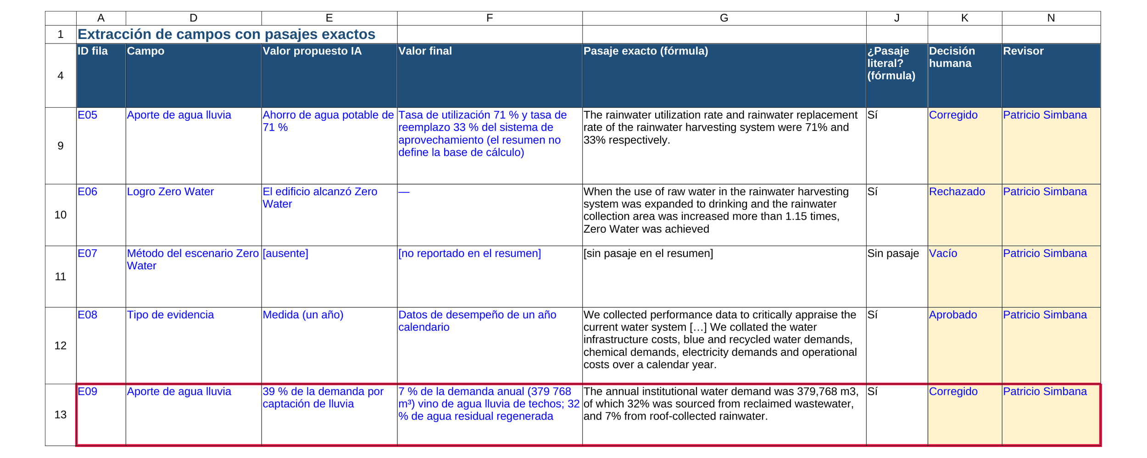
FINAL PROJECT · VIBE CODING CEDIA 2026
Demo · Result
Extraction: AI value, final value and literal passage
Vibe Coding CEDIA 2026 · Universidad UTE · UTPL
8 / 10
Notes:
NARRATION · ≈35 s · 80–90 words in English
This is the central result. Each row shows the value proposed by the A I and the final value set by the person. Next to them is the exact passage. A formula checks that it appears word for word in the publisher's abstract. Look at the row highlighted in red. The A I said rain supplied thirty-nine percent of a campus's water. The passage says seven percent from rain and thirty-two percent from reclaimed wastewater. The person corrected it and signed the change.

Slide 9
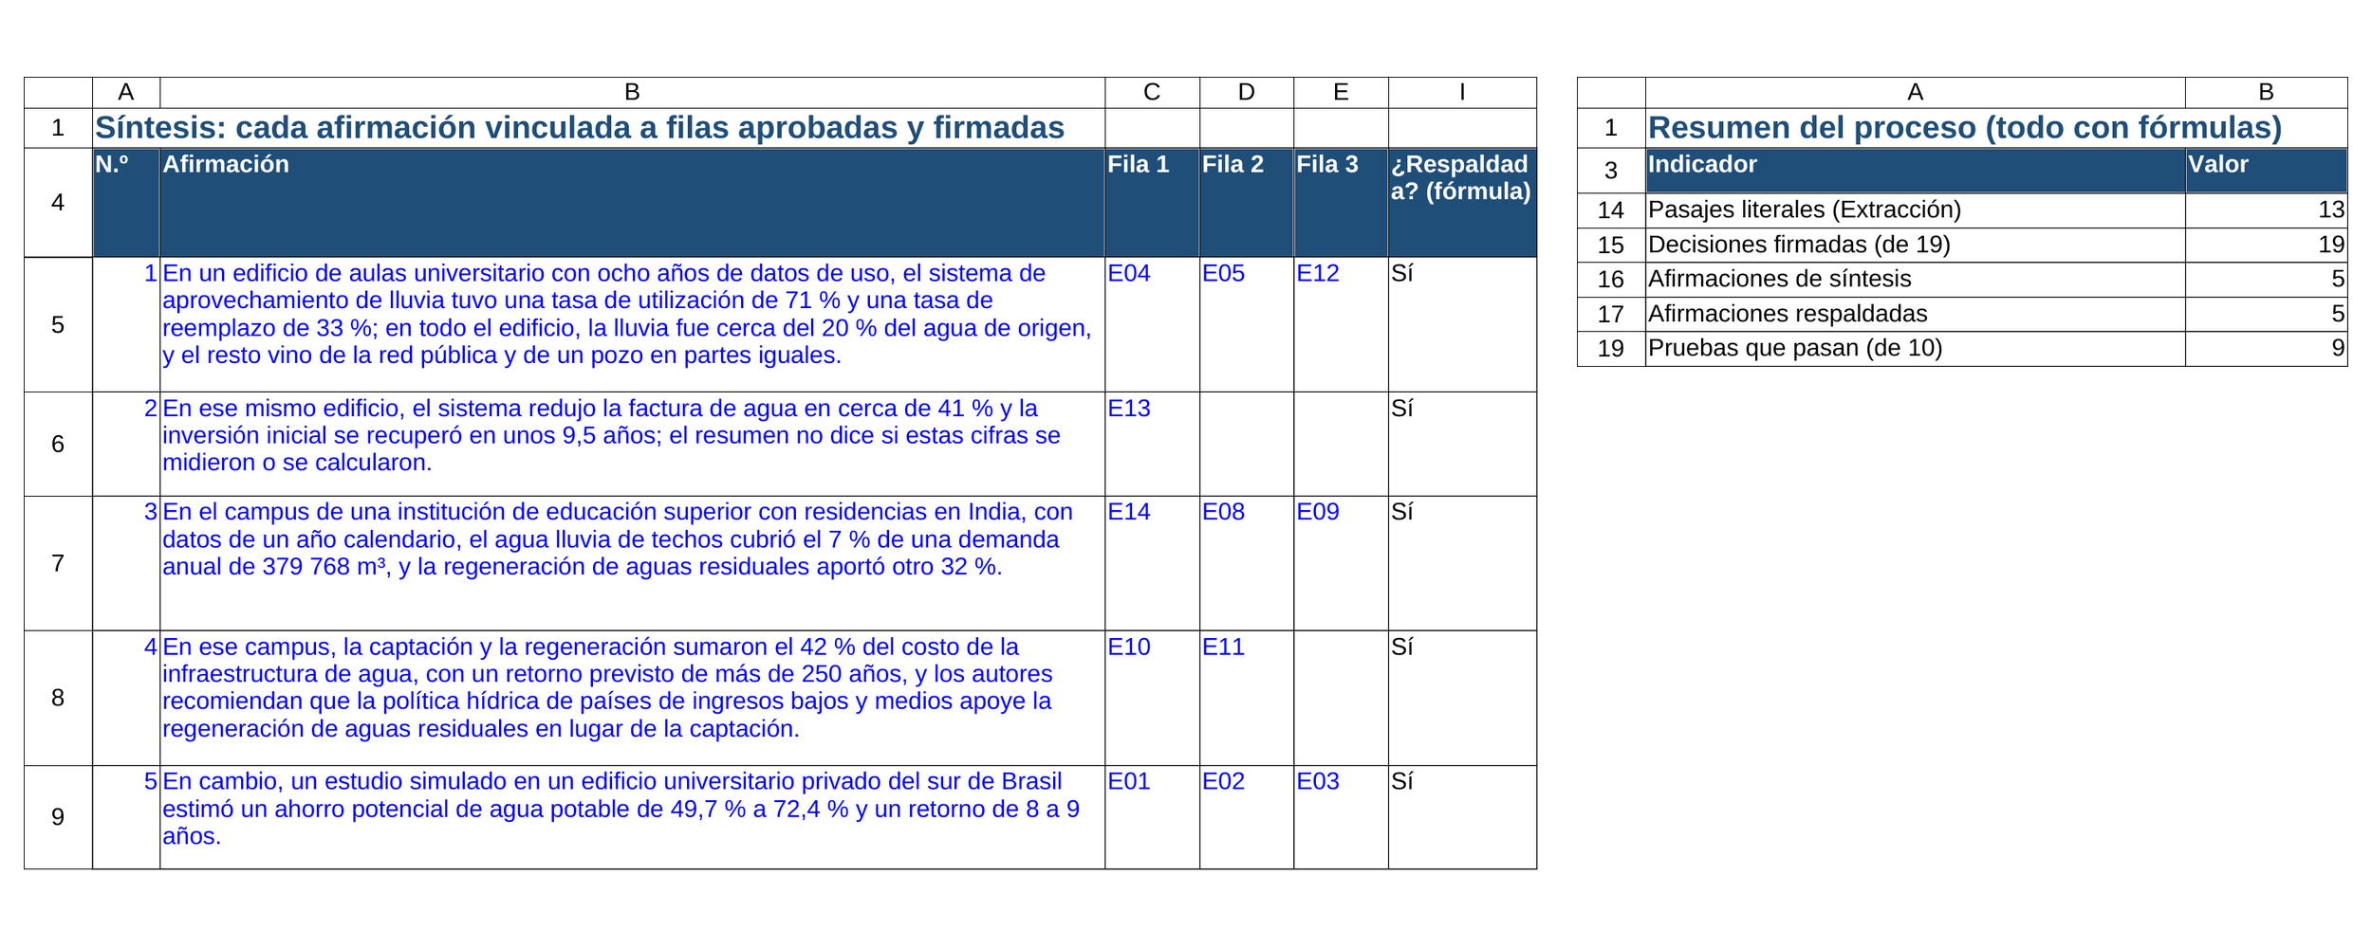
FINAL PROJECT · VIBE CODING CEDIA 2026
Demo · Review and delivery
Synthesis with signed rows and a formula-based summary
Vibe Coding CEDIA 2026 · Universidad UTE · UTPL
9 / 10
Notes:
NARRATION · ≈30 s · 70–80 words in English
The deliverable is the synthesis. It has five claims and each one cites its rows. A formula confirms that all those rows are approved and signed. On the right the summary counts everything with formulas. Nineteen of nineteen decisions are signed. Nine of ten tests pass. The tenth is the incomplete reference. A person confirmed its identifier in the original source. So any colleague can trace a claim back to its passage.

Slide 10
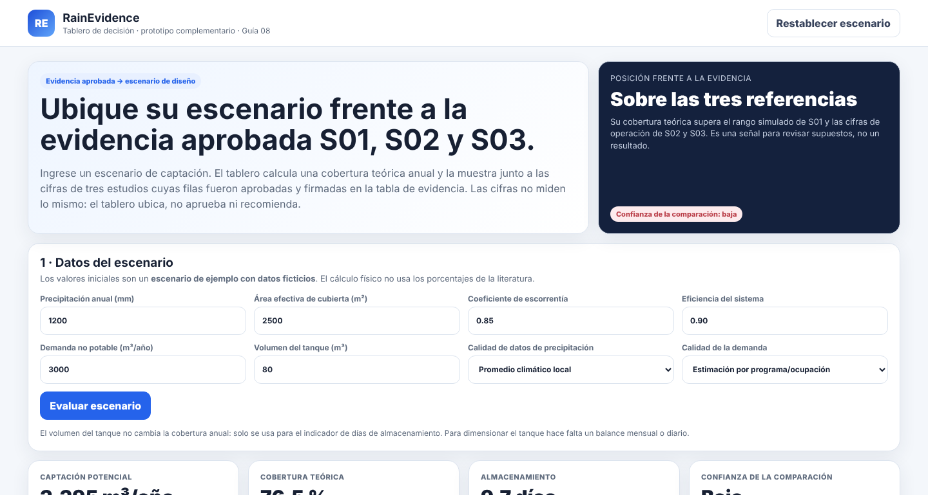
FINAL PROJECT · VIBE CODING CEDIA 2026
Every claim reaches its source and signature
Next step: a research seminar in Moodle.
patriciosimbana.github.io/vibe-coding-proyecto-final
Complement: decision dashboard (prototype)
Patricio Simbaña Escobar · Universidad UTE
Miguel Ángel Botto Tobar · University of Guayaquil
Vibe Coding CEDIA 2026 · Universidad UTE · UTPL
10 / 10
Notes:
CLOSE · NARRATION · ≈25 s · 55–65 words
With this tool every claim reaches its source and a signature. The A I proposes and we decide. As a complement we built a dashboard that compares a design scenario with this evidence. Next we will use the tool in a research seminar. We invite you to try it. The link is on screen. Thank you for your feedback.

